Slide 1
RainTree HOA 2025 Budget
January 23, 2025

Slide 2
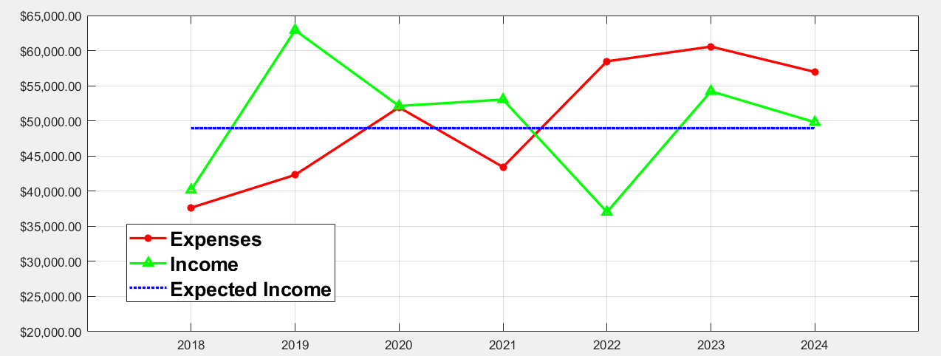
Recent Annual Expenditures
Blue dotted line is expected income at current dues rate.
From 2022-2024 expenses have substantially exceeded income.
Association avoided insolvency due to 2019 effort to collect overdue dues, which resulted in a windfall.
Current situation is untenable: the HOA administration is seeking to reduce expenditures.

Slide 3
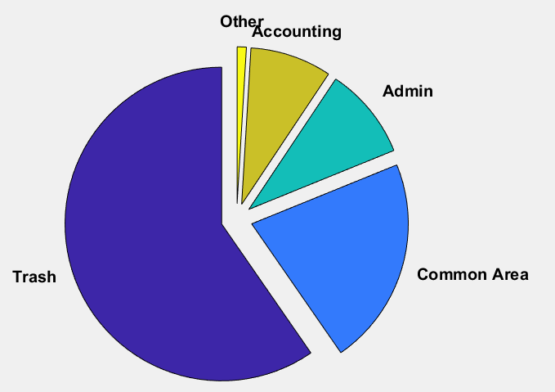
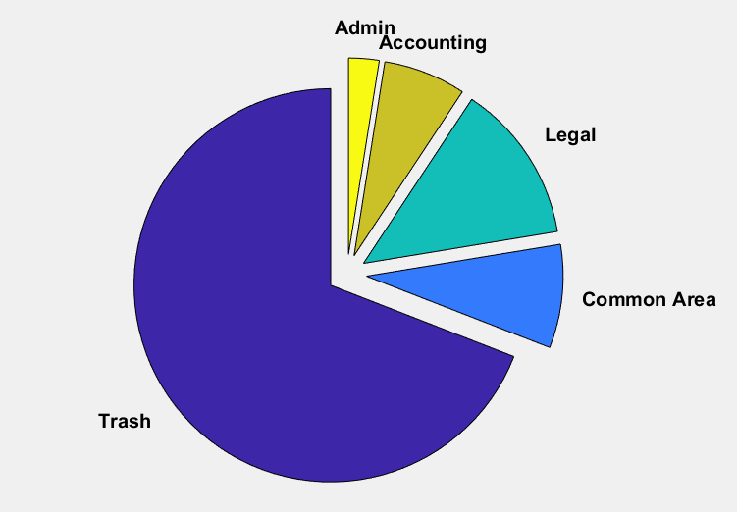
Recent Expense Breakdown
2023 Expenses
Category | Amount
Trash Service | $36,130
Common Area Maintenance | $13,015
Administration | $5,755
Accounting | $5,098
Other | $576
Total: | $60,574
2023
Administrative costs are the business costs of running the HOA, including website hosting, insurance printed material distribution, etc.
Common area costs are mostly dangerous tree removal.
2024 Expenses
Category | Amount
Trash Service | $39,360
Legal | $7,470
Common Area Maintenance | $4,850
Administration | $1,430
Accounting | $3,860
Total: | $56,970
2024

Slide 4
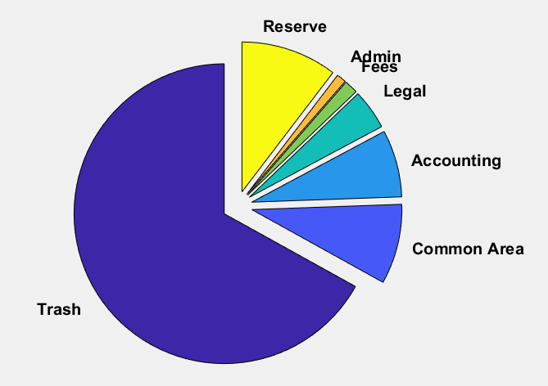
2025 Proposed Budget
Category | Projection
Trash Service | $38,760
Common Area Maintenance | $5,000
Accounting | $4,200
Legal | $2,500
Insurance/State Fees | $850
Administration | $600
Reserve | $6,000
Total | $57,910
Establishing a reserve is necessary to cover unanticipated expenses, e.g., storm damage, legal expenses, etc.
Goal is to eventually reach $30,000 in reserve.

Slide 5
Expense Reductions
Trash costs are fixed and make up the bulk of dues.
  Without the HOA contract, trash pickup would be $93 per quarter by itself ($372/year).
Reduce administrative costs by discontinuing most paper mail notices.
  Printing, labelling, and mailing 170 notices is expensive.
  Email and website contact is easier and more cost effective.
  Dues invoicing is provided by accounting firm and will still be paper mailed.
Limit legal counsel involvement unless necessary.
Despite the above efforts, there may be a necessary dues increase in 2026 due to rising costs; however, it is still likely to be less than the cost of trash pickup alone without the group HOA rate.

Slide 6
2025 Dues
2025 will bring a change to dues collection:
  Dues has been collected in arrears for years. This means that dues invoices covered the previous year instead of the coming year.
  Moving forward, dues will be collected for the next year.
  This change will put us in alignment with standard accounting practices and typical HOA operations.
  The upcoming billing cycle will, therefore, cover both all of 2024 and all of 2025.
  After analyzing our finances, we are aiming to reduce the 2025 dues from $288 to $100. This is a one-time reduction and only for 2025 to compensate for the change in billing practice.
  The 2025 invoice will be for $388 ($288 fom 2024 and $100 for 2025), plus any outstanding (unpaid) balance from previous years. Homeowners will, of course, receive full credit for any amount that was paid ahead.

